Slide 1
Ranking YouTube Videos With Sentiment Analysis
Wilson Kung
August 2015

Slide 2
Overview
Problem
How to figure out which YouTube video to watch among ones that are returned given your query?
Solution
Use sentiment of the comments of each video to determine which are the best videos to watch

Slide 3
Example Use Cases
Find Best Videos to:
Cure Yourself of a Headache
Learn Hadoop
Make Yourself Laugh

Slide 4
Sentiment Score Calculation
BeautifulSoup to scrape comments of the videos given a query
Used Monkey Learn to extract sentiment of comments
Sentiment Score = (# Positive – Negative) / Total
Number between -1 and 1
Adjusted for total number of comments using sigmoid
Each query took ~ 2 mins to calculate sentiment score so sentiment scores were stored in MongoDB database

Slide 5
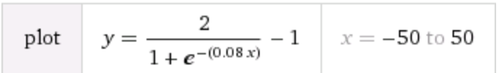
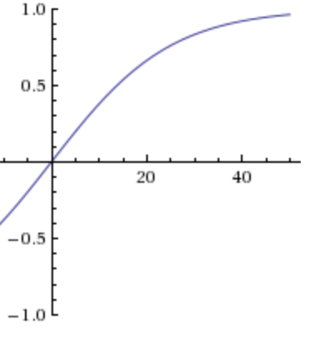
Custom Sigmoid to Adjust Sentiment Score for Number of Comments

Slide 6
Query: “Hawaii”
lUTHnxoEOPQ 57.7%
V9YvCuLzFHc 55.7%
0TraYbBVRH4 54.9%
xjfVDxttN7Y 53.8%
fahr069-fzE 49.7%
9BgiIfaXTtA 41.4%
SdIaEQCUVbk 39.9%
hwhvByj8YG8 33.8%
ZAjASemgx3E 21.6%
vSROSencBss 17.0%
Q8NXO6YxBmU 12.9%
Qwr6yMcD7Kk 12.7%
ccnwzScp6bM 12.2%
9g-5J05BIiQ 11.9%
B9FhV3BG58U 9.3%
UxJxF_peIp0 0.0%
3zxAX6ozbgk 0.0%
DHHAR1S_eKA 0.0%
QguEfBMhpyc -43.7%
Why??

Slide 7

Query: “Hawaii” Highest Sentiment Score

Slide 8
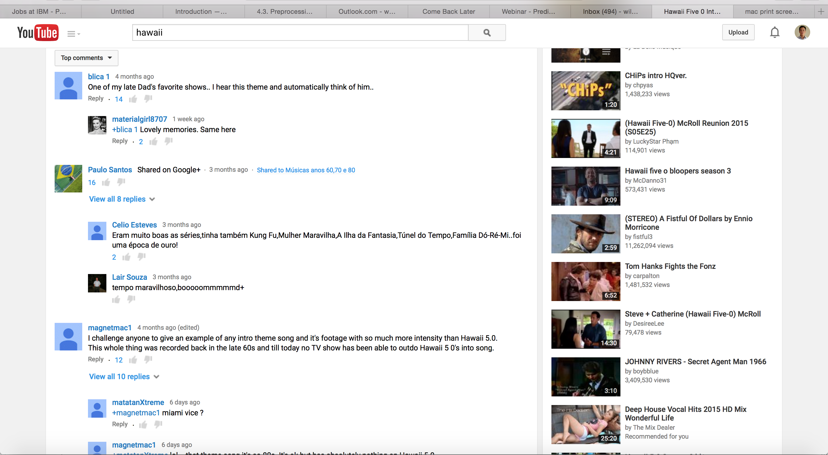
Comments

Slide 9
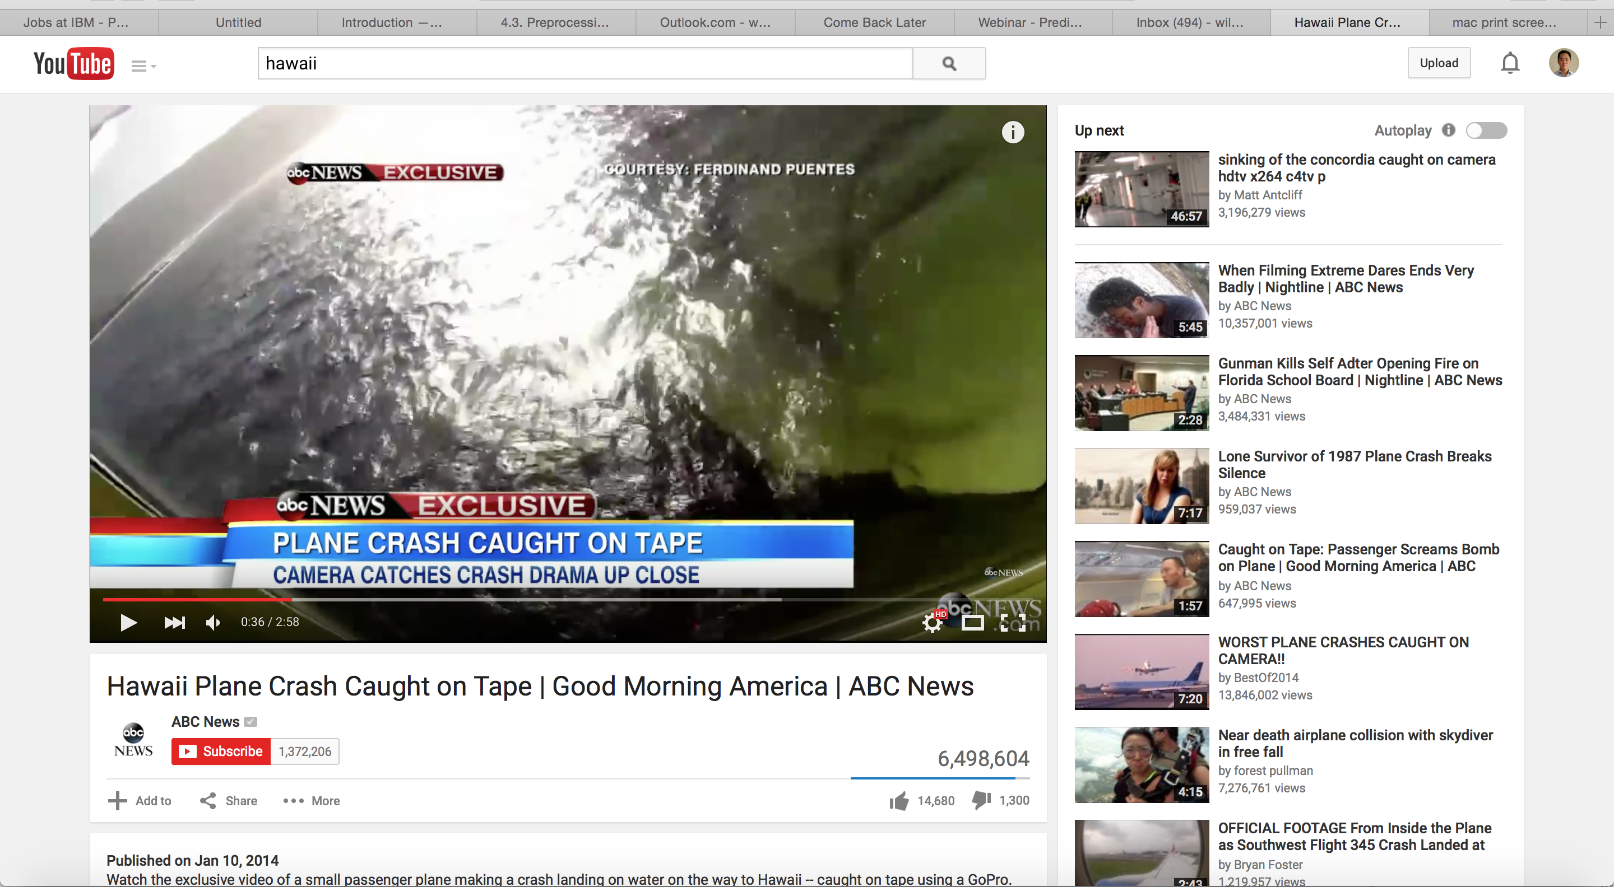
Query: “Hawaii” Lowest Sentiment Score

Slide 10

Query: “Home Remedies for Headaches”

Slide 11
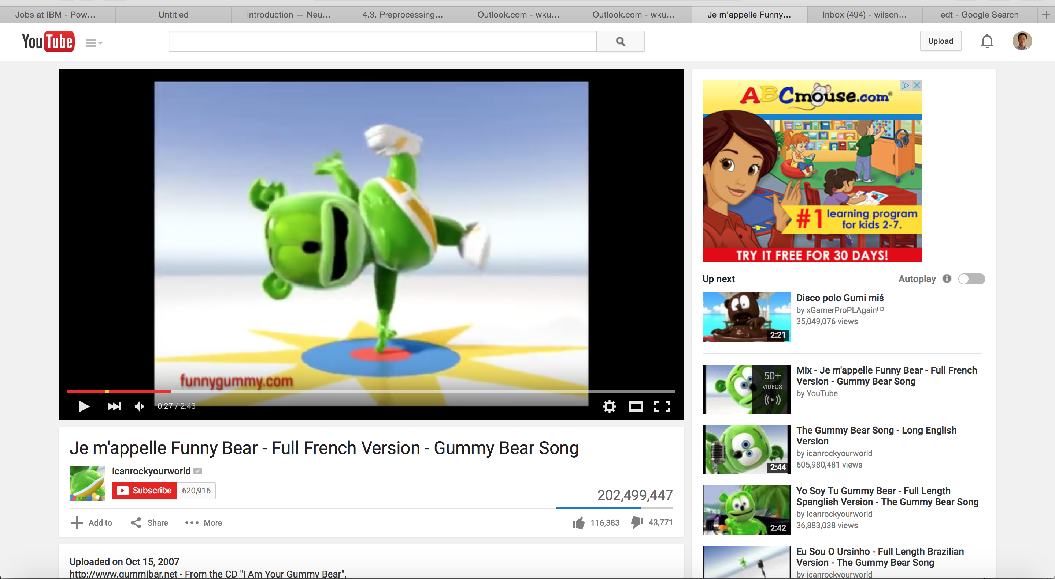
Query: “Funny”

Slide 12
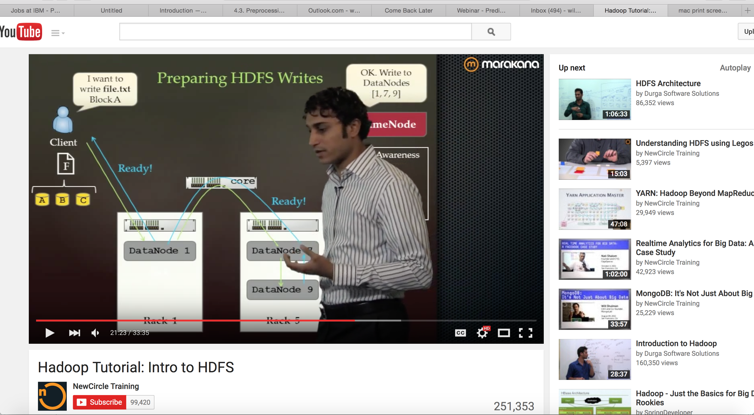
Query: “Learn Hadoop”

Slide 13
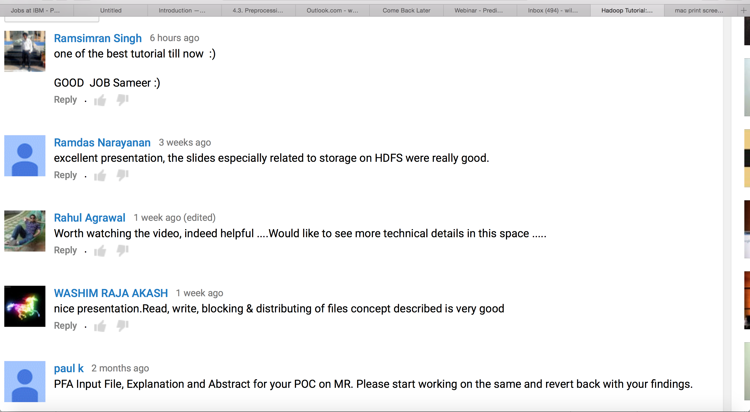
Comments

Slide 14
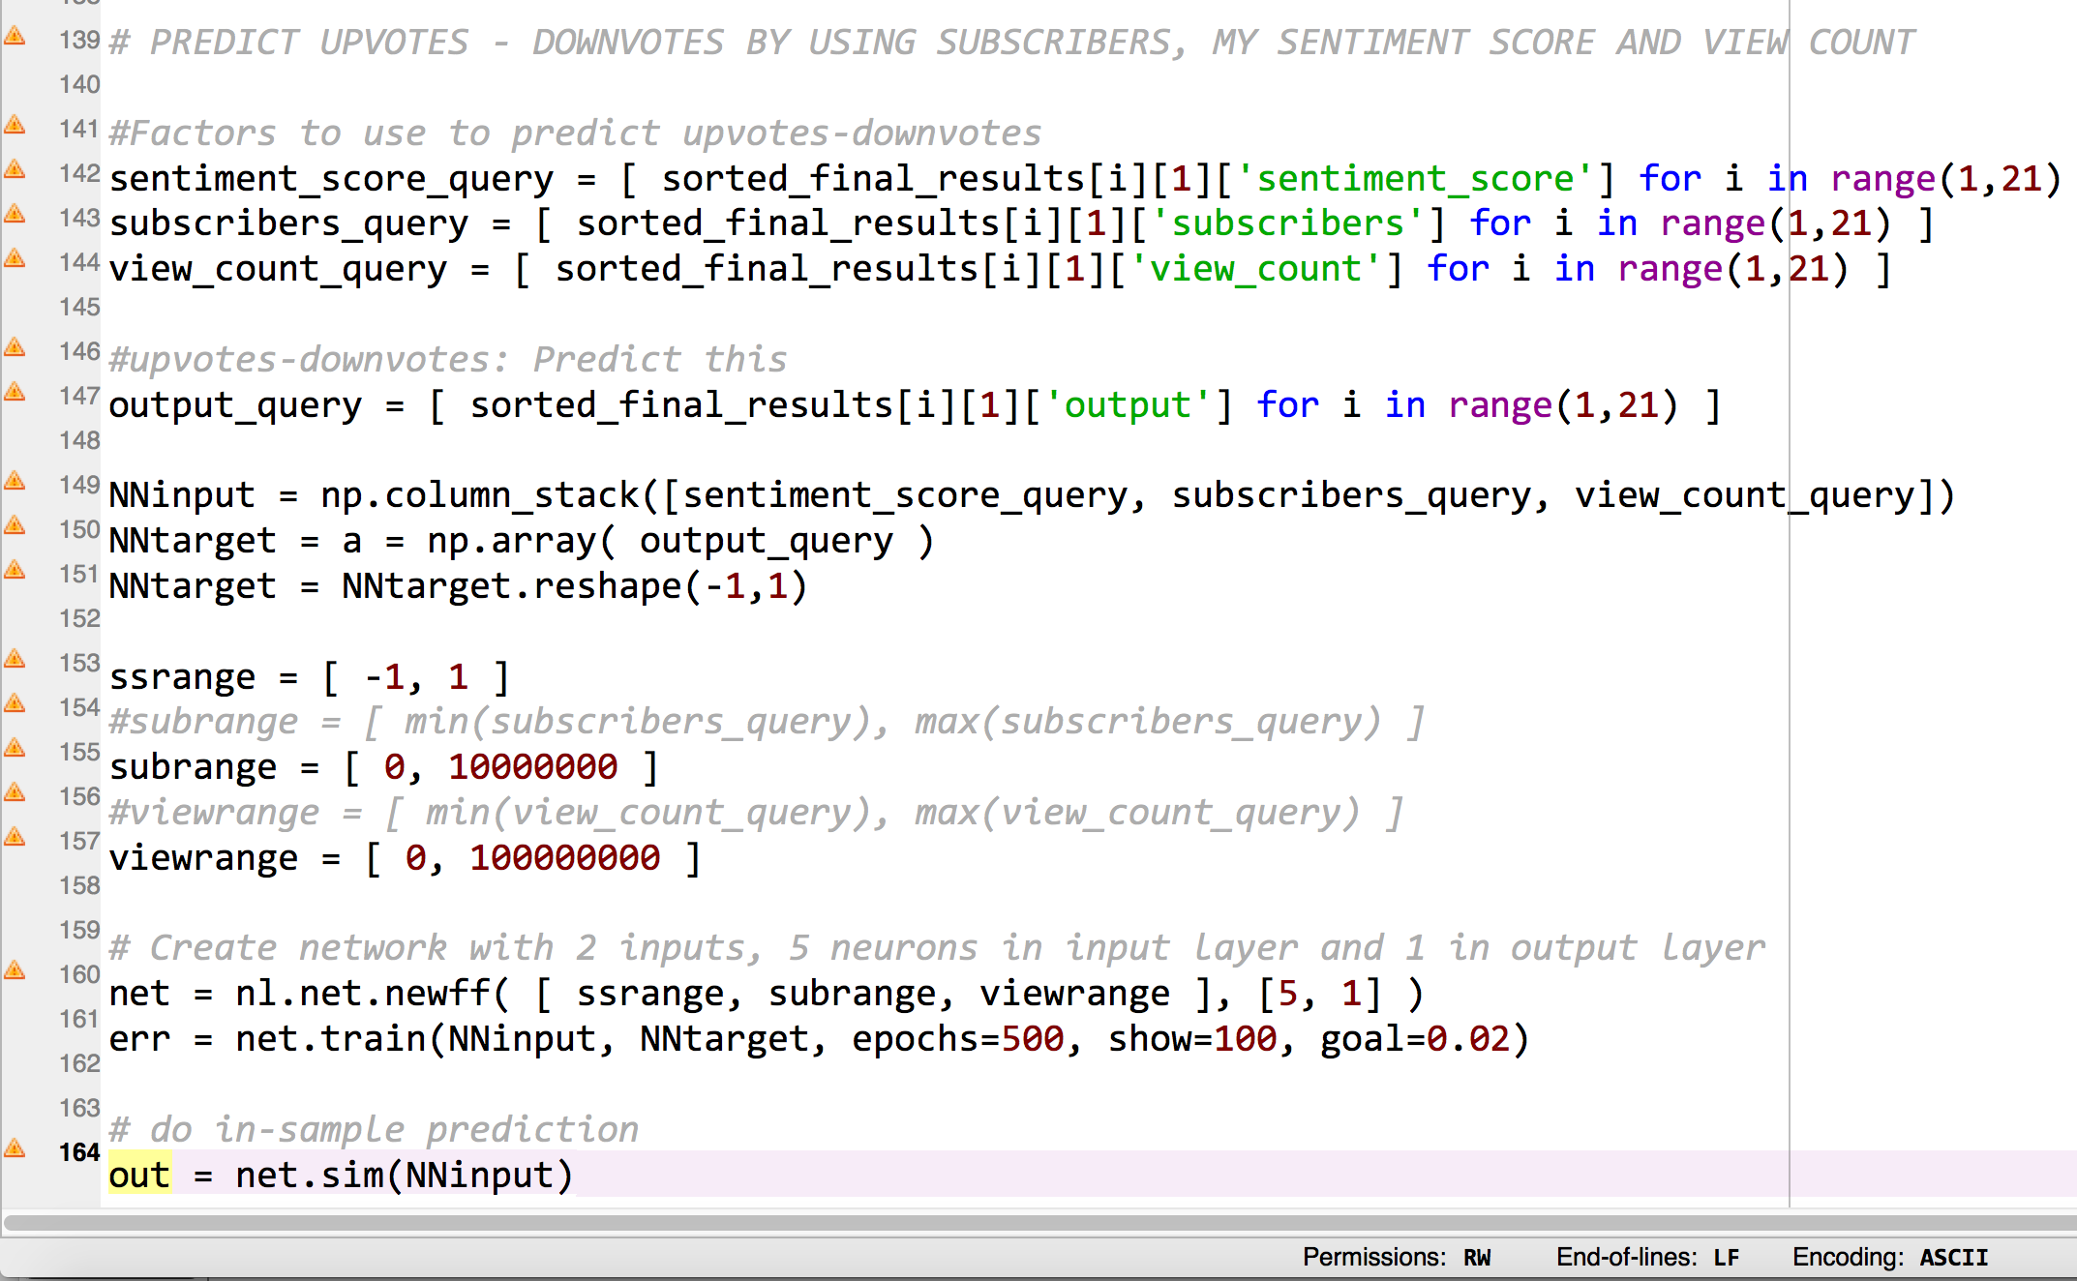
Extra: Using Neurolab’s Neural Network to Predict Upvotes vs. Downvotes

